Slide 1
Spooky Stories of Data and Equity
NYC DEpartment of Health and mental hygiene presents...
Question Wording and Response Sets for Disaggregated Racial/Ethnic Data

Slide 2
Who We Are

Slide 3
Guiding Principles and Theory

Slide 4
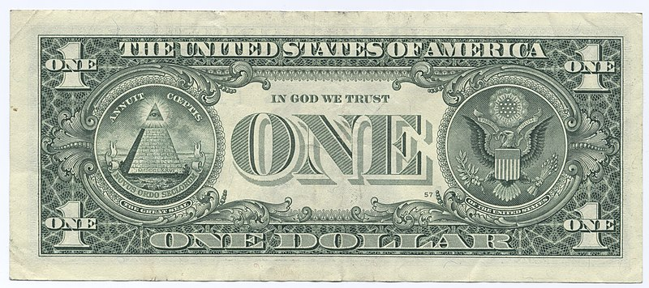
Demographic data measures social constructs
https://commons.wikimedia.org/wiki/File:United_States_one_dollar_bill,_reverse.jpg

Slide 5
Social construction reflects oppression
As defined by Iris Young in “Five Faces of Oppression,” oppression is when people reduce the potential for other people to be recognized as fully human.
“This could mean treating them in a dehumanizing manner. But, it could also mean denying people language, education, and other opportunities. People should be free to pursue life plans in their own way. Oppressive forces seek to diminish those plans and thus those people as well.
People are not always oppressed by cruel tyrants with bad intentions. In many cases, a well-intentioned progressive society can place system-wide constraints on groups. Oppression can be the result of a few people’s choices or policies that cause embedded unquestioned norms, habits, and symbols.”1
exploitation: marginalization: powerlessness : cultural imperialism: violence
Iris Young. “Five Faces of Oppression.” Originally published in Oppression, Privilege, & Resistance edited by Lisa Heldke and Peg O’Connor. McGraw Hill. Boston, 2004. https://mrdevin.files. wordpress.com/2009/06/five-faces-of-oppression.pdf

Slide 6
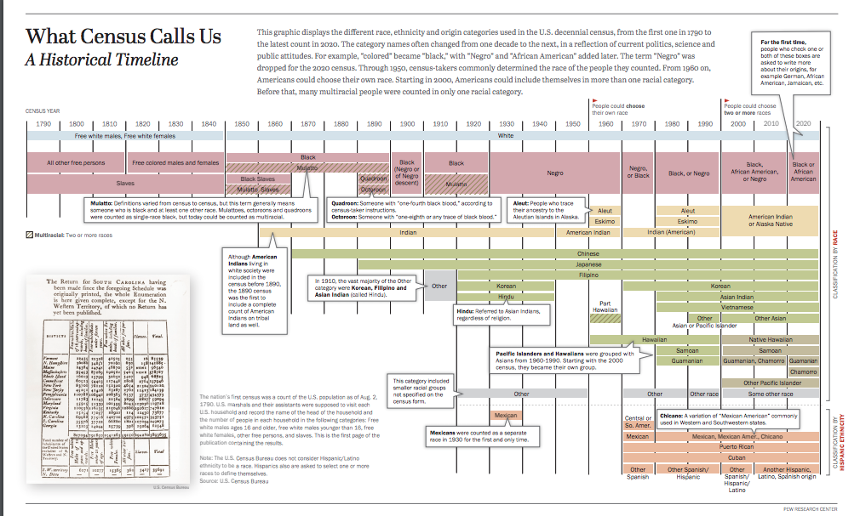
Social Construction of Race in the US
Please explore more at Pew Research’s interactive timeline at https://www.pewresearch.org/interactives/what-census-calls-us/

Slide 7
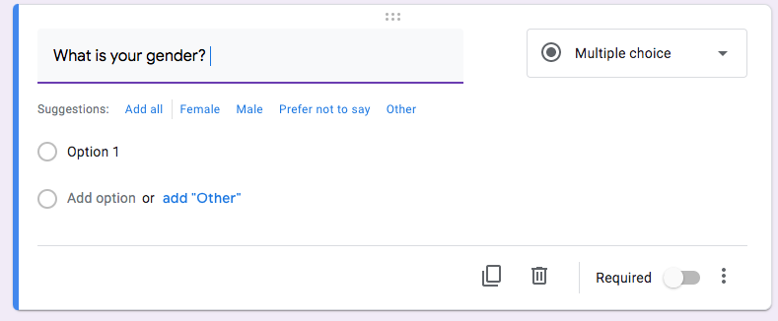
Social Construction of Gender in the US

Slide 8
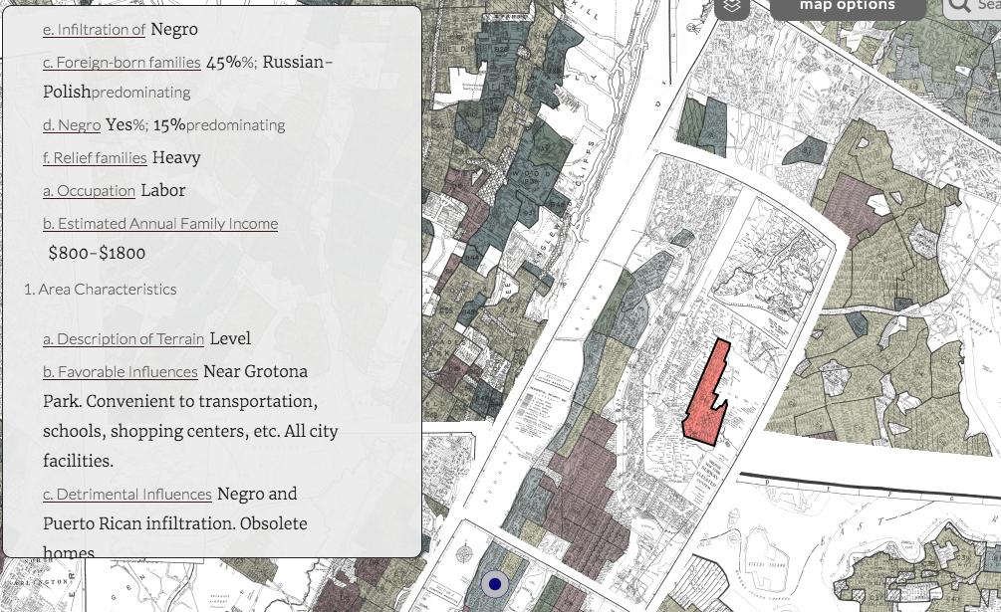
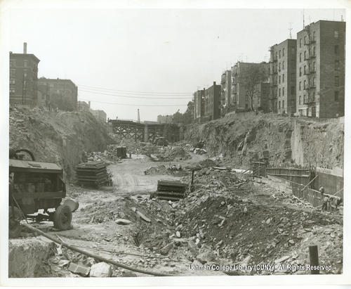
Naming and counting are acts of imposing power
“Desirability”
Urban Renewal
Cross Bronx Expressway Under Construction Lehman College Library, CUNY http://dcmny.org/islandora/object/bronxbusiness%3A248/compound-parent-metadata
Mapping Inequality HOLC Maps https://dsl.richmond.edu/panorama/redlining/#loc=12/40.858/-73.935&city=bronx-ny&area=D4

Slide 9
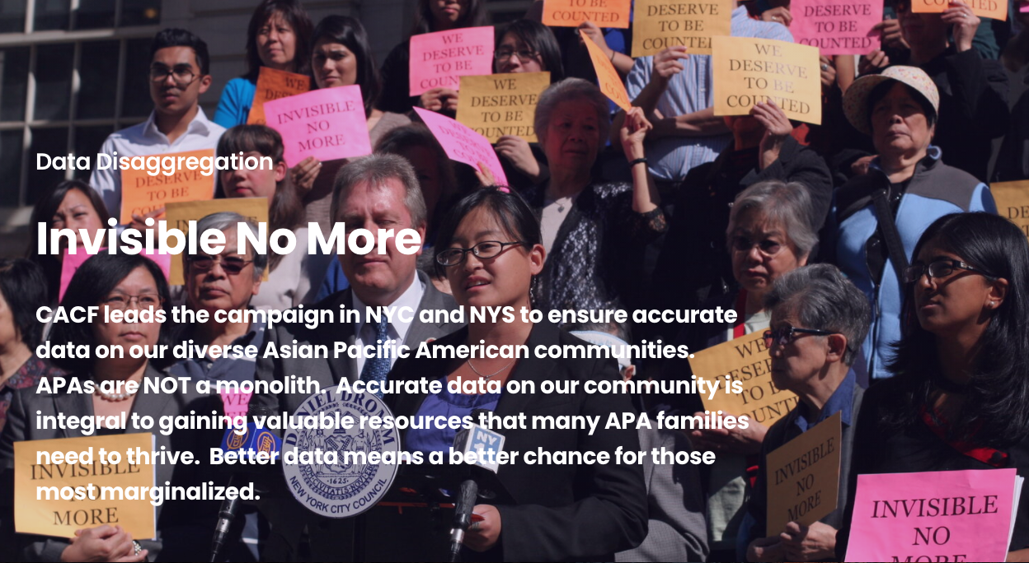
Naming and counting are acts to access power
Please explore more about Coalition for Asian American Children and Families “Invisible No More” campaign at https://www.cacf.org/policy-advocacy/invisible-no-more

Slide 10
When we collect demographic data, what are we trying to do?
Trying to assess lived experience at a particular moment in time

Slide 11
What are some of the diversities in lived experience that might be aggregated under these labels?
Asian
LGBTQ
Indigenous
Puerto rican
Caribbean
Latinx

Slide 12
What can people who work with data do?

Slide 13
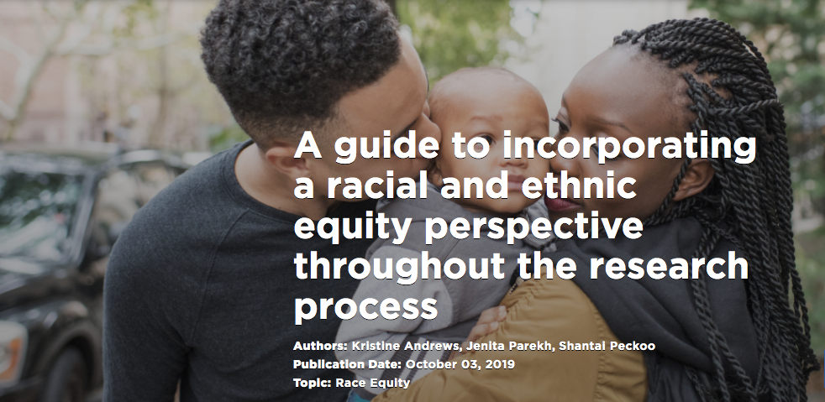
Adopt Emerging Protocols
Please explore Child Trends Guide here

Slide 14
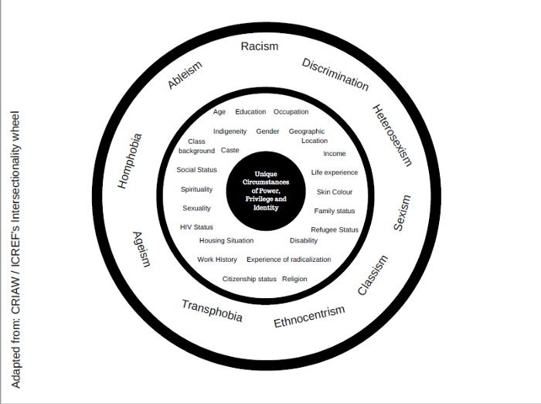
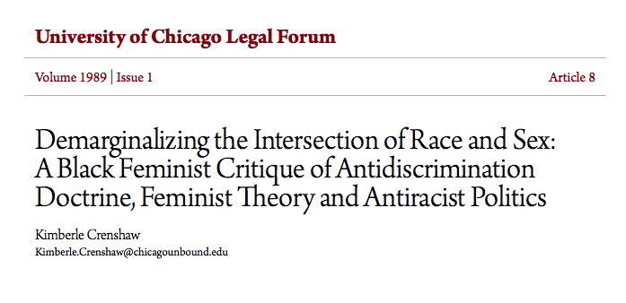
Internal Reform of Self
https://medium.com/the-red-elephant-foundation/understanding-intersectionality-a1da46e2e0b2

Slide 15

Internal Reform of Institution
Advancing
Racial Equity & Social Justice

Slide 16
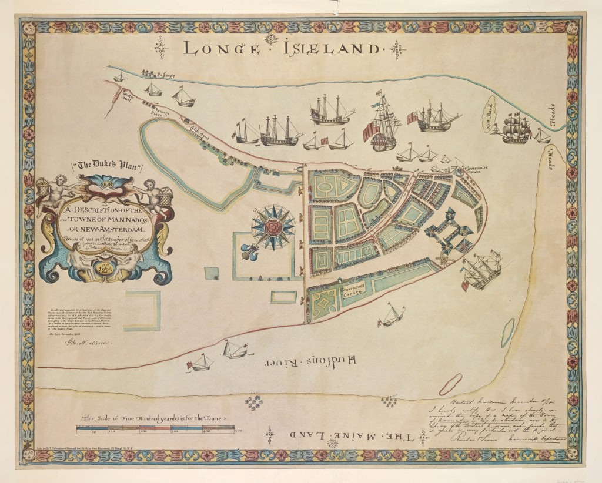
Learn Local History and Context
Map of New Amsterdam in | Date: 1661 | Credit: 1692919 The “Land of the Blacks” was located north of the palisade. Lionel Pincus and Princess Firyal Map Division, The New York Public Library. The New York Public Library Digital Collections. Please explore more at New York Public Library’s Black New Yorkers’ interactive site: https://blacknewyorkers-nypl.org/

Slide 17
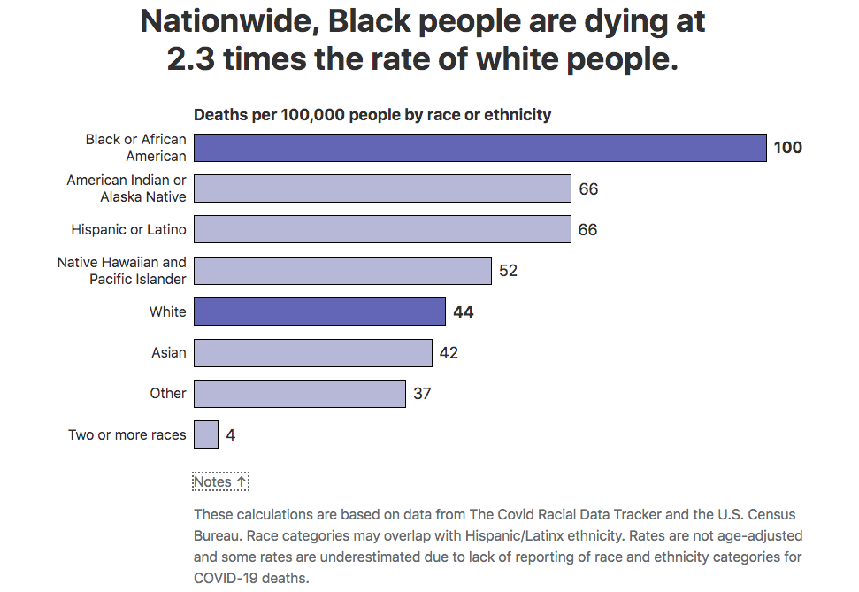
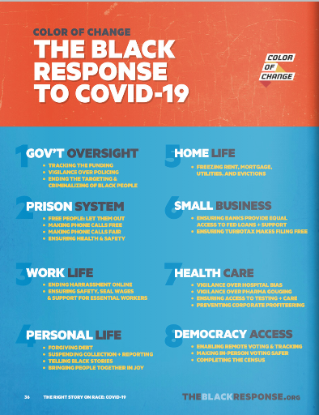
Pull all data in a historical, political, and experiential context
These calculations are based on data from The Covid Racial Data Tracker and the U.S. Census Bureau. Race categories may overlap with Hispanic/Latinx ethnicity. Rates are not age-adjusted and some rates are underestimated due to lack of reporting of race and ethnicity categories for COVID-19 deaths. https://covidtracking.com/race
Please explore more at Color of Change’s TELLING THE RIGHT STORY ON RACE DURING COVID-19 at https://colorofchange.org/narrativepower/#book1

Slide 18
Data Instruments in NYC

Slide 19
Population Based Survey Tools
Community health survey (chs)
(Adults)
Youth risk behavior survey (YRBS)
Nyc
Kids
(Kids 1-13)

Slide 20
Ongoing Development and Refinement of Racial/Ethnic Categories

Slide 21
What is our Baseline for Race/Ethnicity Questions?
Standard OMB Categories
Are you Hispanic or Latino? (Y/N/DK/R)
Which one or more of the following would you say is your race? (Read by interviewer)
White; Black or African American; Asian; Native Hawaiian or other Pacific Islander, American Indian, Alaska Native or Something else (specify)
Which one of these groups would you say best represents your race?

Slide 22
Evolution of Race/Ethnicity Questions in CHS
Middle Eastern/North African Option Added to Race Question
Removal of follow-up race question
Terminology expanded for Native American/Indigenous in Race Question
Latino/Hispanic Heritage Question Added
2012
2019
2021
2003
2017
2020
Asian Heritage Question Added
+ Latino heritage updates + Black Heritage Question Added
+ Add Native American/Indigenous heritage questions
+ Make all heritage questions multiple select

Slide 23
Latino Heritage Question
2003
Please tell me which group best represents your Hispanic or Latino origin or ancestry: (read by interviewer - one response allowed)
Puerto Rican
Cuban
Domincan
Mexican
Central or South American
Other Latin American
Other Hispanic/Latino
Spanish
~25% reporting “other” latino heritage

Slide 24
Asian Heritage Question
2012
Please tell me which group best represents your Asian heritage or ancestry: (read by interviewer - one response allowed)
Chinese
Asian Indian
Filipino
Korean
Japanese
Vietnamese, or
Something else (specify)
* Other specify option accepted

Slide 25
Middle Eastern/
North African Option
2017
Which one or more of the following would you say is your race?
MULTIPLE SELECT
White
Black or African American
Asian
Middle Eastern or North African
Native Hawaiian or other Pacific Islander,
American Indian, Alaska Native
or Something else (specify)

Slide 26
Changes to Latino Heritage Question
2019
Please tell me which group best represents your Hispanic or Latino origin or ancestry: MULTIPLE SELECT
Puerto Rican
Dominican
Mexican
Ecuadorian
Columbian
Cuban
Other Central American
Other South American
Something else (specify)
Spanish
2018 “other” = 27.6%
2019 “other” = 16.0%

Slide 27
Black
Heritage Question
2019
Some people, in addition to being Black, have a certain heritage or ancestry. Do you identify with any of these? MULTIPLE SELECT
African American (READ ONLY IF NEEDED: Descended from people who were enslaved in the US),
Caribbean or West Indian (READ ONLY IF NEEDED: Descended from people who were enslaved in Caribbean and West Indian countries),
A recent immigrant or the child of recent immigrants from Africa, or
Another group? (SPECIFY: What other heritage or ancestry do you identify with?)

Slide 28
Native American/
Indigenous Option
2020
Which one or more of the following would you say is your race?
MULTIPLE SELECT
White
Black or African American
Asian
Middle Eastern or North African
Native Hawaiian or other Pacific Islander,
American Indian, Native, First Nations, Indigenous Peoples of the Americas, or Alaska Native
or Something else (specify)

Slide 29
Indigenous Heritage Question
2021
You said you were American Indian, Native, First Nations, Indigenous Peoples of the Americas, or Alaska Native. Please tell me which group best represents your tribal heritage or ancestry?
Iroquois or Haudenosaunee
Blackfeet
Cherokee
Choctaw
Sioux
Central American Indian (For example, Mayan- K’iche’, Mam, Yucatan, Garifunas, among others)
Mexican American Indian (For example, Mixteco, Nahua, Otomi, Tlapaneco, among others)
Southern American Indian (For example, Quechua, Kichwa, Shuar, Aymara, among others)
Something else? (specify)

Slide 30
Indigenous Heritage Question
Are you enrolled in a tribe that is recognized by the US federal government, a state government, or a government in another country?
Yes
No
My tribe is not recognized by any government.
2021

Slide 31
Further changes in 2021
Alphabetize race categories
All Heritage questions multiple select with other specify
2021

Slide 32
Child Health Instruments
NYC Kids Survey

Slide 33
Race/Ethnicity Question
- | RACE/ ETHNICITY | LATINO ANCESTRY | ASIAN ANCESTRY | BLACK ANCESTRY | MENA ANCESTRY | AI/AN HERITAGE
2017 | -Parent 1 -Parent 2 -Child | -Parent 1 -Parent 2 -Child | -Child
2019 | -Child | -Child | -Child
2021 | -Parent 1 -Parent 2 -Child | -Parent 1 -Child | -Parent 1 -Child | -Parent 1 -Child | -Parent 1 -Child | -Parent 1 -Child

Slide 34
Nativity Question
2017-2019
2021
Where were you born?
USA
Puerto Rico, Guam, U.S. Virgin Islands or other U.S. territory
Outside USA
Where were you born? Please tell me the country or U.S. Territory
USA
Outside USA
INTERVIEWER NOTE: PUERTO RICO AND OTHER US TERRITORIES ARE CONSIDERED OUTSIDE OF THE UNITED STATES

Slide 35
Small but Mighty Changes
Switch to gender neutral language
Alphabetize answer choices for race/ethnicity and sexual orientation/gender identity questions

Slide 36
Child Health Instruments
Youth Behavior Risk Survey

Slide 37
Race/Ethnicity Questions
2017 - HS
2003 - HS
Are you Hispanic or Latino?
Yes
No
How do you describe yourself?
(Select one or more responses.)
American Indian or Alaska Native
Asian
Black or African American
Hispanic or Latino
Native Hawaiian or Other Pacific Islander
White
How do you describe yourself?
(Select one or more responses.)
American Indian or Alaska Native
Asian
Black or African American
Native Hawaiian or Other Pacific Islander
White

Slide 38
Race/Ethnicity Questions
2020 - MS
How do you describe yourself?
(Select one or more responses.)
American Indian or Alaska Native
Asian
Black or African American
Middle Eastern or North African
Native Hawaiian or Other Pacific Islander
White
Another race not listed
Are you Hispanic or Latino?
Yes
No
Also included:
Latino Ancestry
Asian Ancestry

Slide 39
SOGI Questions
2017 - HS
What is your sex?
Male
Female
Some people describe themselves as transgender when their sex at birth does not match the way they think or feel about their gender. Are you transgender?
No, I am not transgender
Yes, I am transgender
I am not sure if I am transgender
I do not know what this question is asking
Which of the following best describes you?
Heterosexual (straight)
Gay or lesbian
Bisexual
Not sure
I do not describe myself in any of these ways
I do not know what these answer options mean
What sex is on your birth certificate?
Male
Female
Not sure

Slide 40
SOGI Questions
2018 - MS
A transgender person is someone who does not feel the same inside as the sex they were born with. Are you transgender?
No, I am not transgender
Yes, I am transgender
I do not know if I am transgender
I do not know what this question is asking
Who are you sexually attracted to?
Girls
Boys
Girls and boys
Not sure
What is your sex?
Male
Female

Slide 41
Lessons Learned
More flexibility with CHS and KIDS vs YRBS (CDC)
Leadership Buy-In
Space limitations
Community-informed process
Agency-wide collaboration

Slide 42
Next Steps
Broadening involvement in survey design process
More intentional with questions that relate to agency’s Race to Justice mission
Institutionalizing changes / Accountability
Move to Address Based Sampling (ABS)

Slide 43
Data Dissemination in NYC

Slide 44
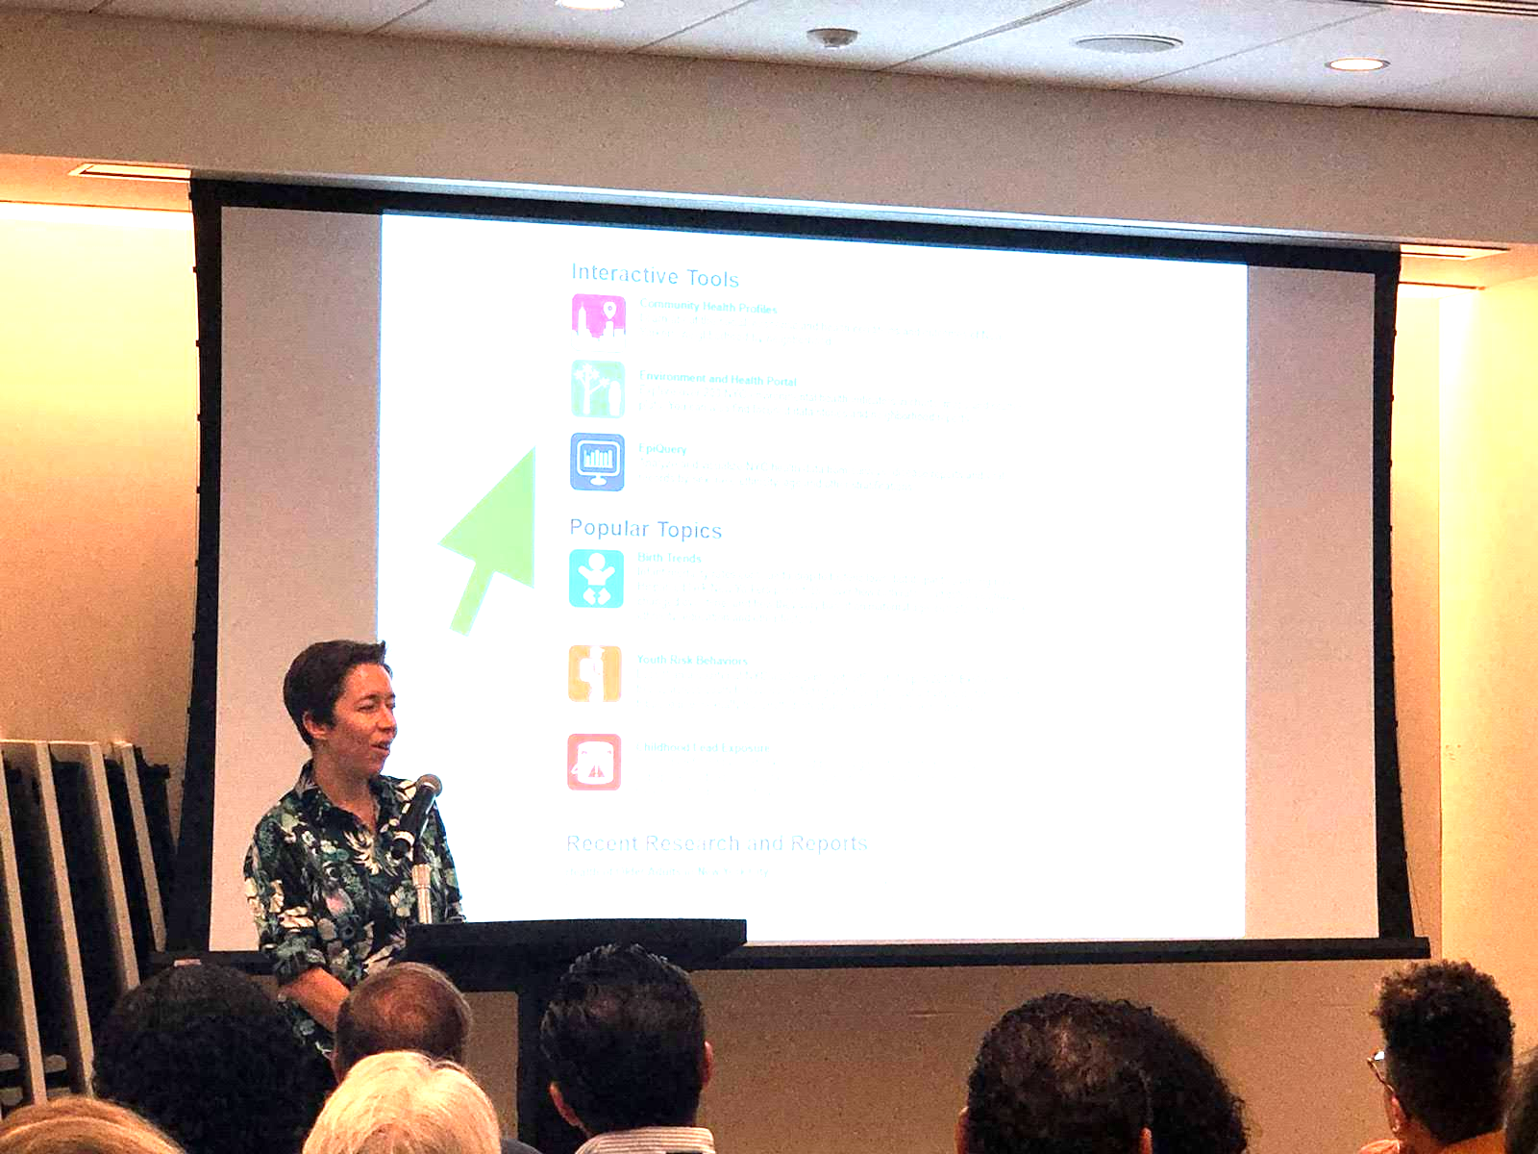
Using Data to Advance Health Equity
Know your community
Understand local health conditions and inequities
Allocate
Make decisions about programming and funding
Advocate
Frame issues, build support for policy solutions
Teach
Inform/guide students, researchers, and stakeholders

Slide 45
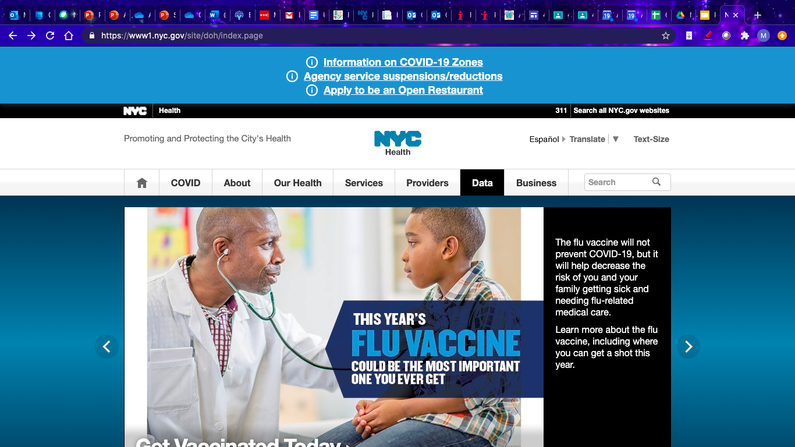
Start at www.nyc.gov/health

Slide 46
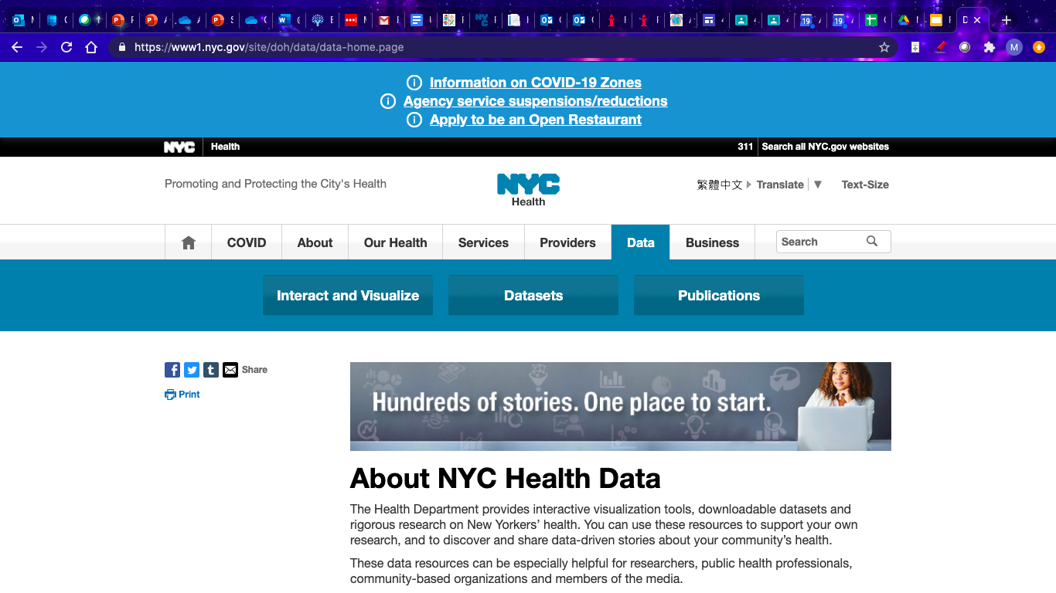
Or start at www.nyc.gov/health/data

Slide 47
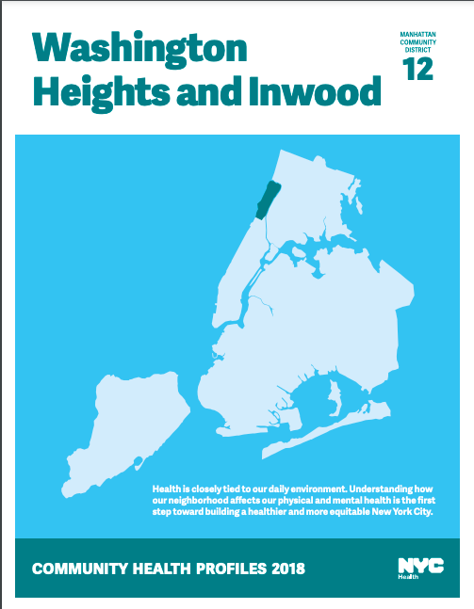
Putting Health Data in Context
The ability to live a long and healthy life
is not equally available to all New Yorkers.
Since the 1600s—when NYC was established by colonization—racist policies and practices have
shaped where New Yorkers live and go to school, what jobs they have and what their neighborhoods look like.
These data should be interpreted with an understanding that good health is not only determined by personal choices. Many other factors shape differences in health outcomes…

Slide 48
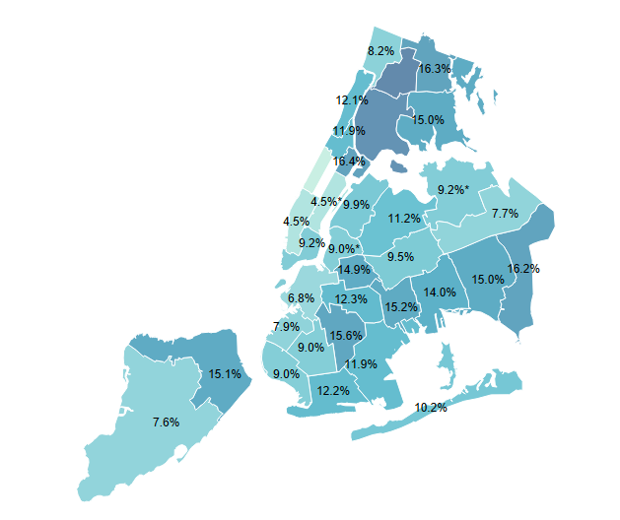
Recognizing Historical Context
Diabetes prevalence varies by neighborhood,
mirroring historical inequities

Slide 49
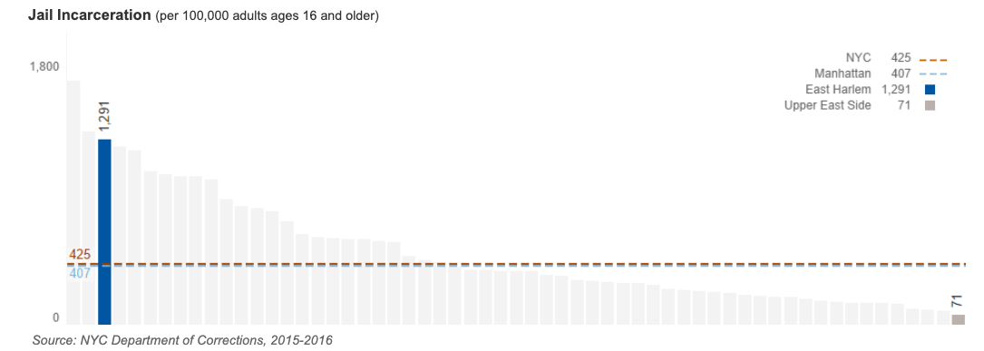
Naming Systems - Incarceration
Incarceration takes a toll on individuals, families, and communities.
Black and Latino New Yorkers experience higher policing compared with non-Latino White New Yorkers.

Slide 50
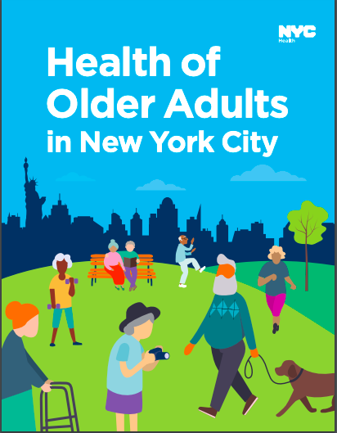
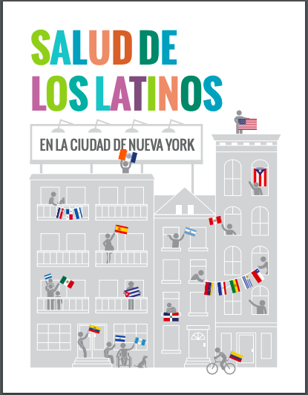
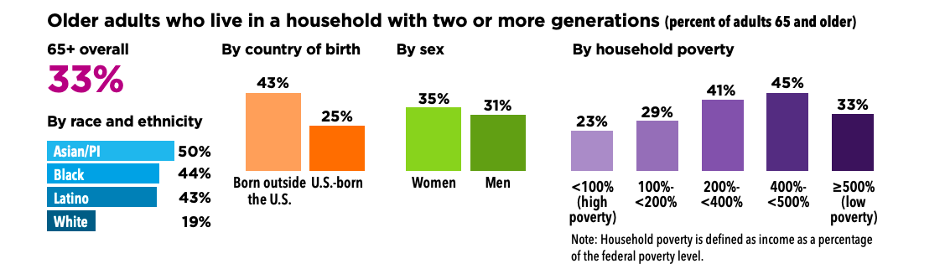
Disaggregation in Special Reports

Slide 51
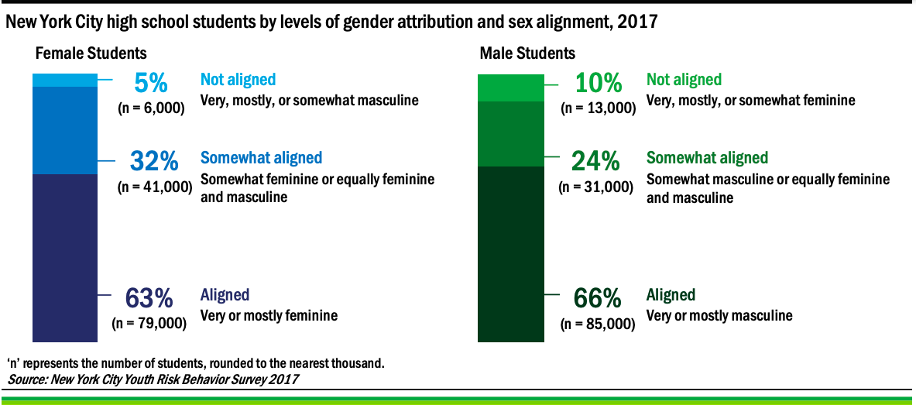
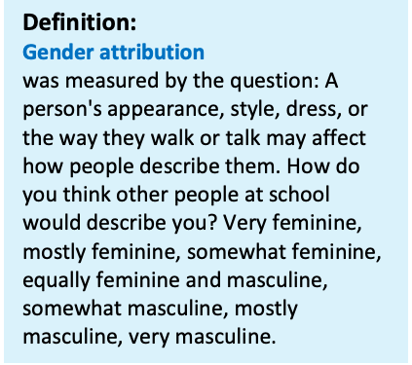
Disaggregation - SOGI Data
Over a third of students reported gender attributions that were
not aligned with the social expectations of their sex.

Slide 52

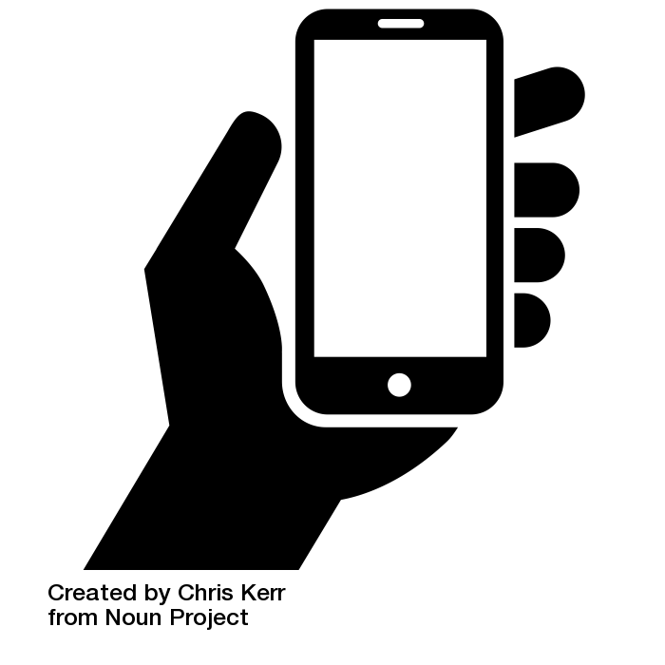



Making Data More Accessible and Easier to Use
Guided Analytics
User Personas
Visualizations - Mobile Enabled
Download - Share - Print

Slide 53
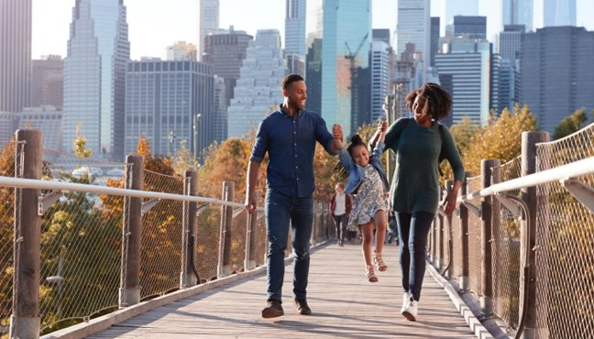
nyc.gov/health/data | query@health.nyc.gov

Slide 54
Lots More to Be Done!

Slide 55
Thanks!
Stephanie Farquhar - sfarquhar@health.nyc.gov
Michael Sanderson - msander1@health.nyc.gov
April Aviles - aaviles2@health.nyc.com
Martha Alexander - malexan1@health.nyc.gov
nyc.gov/health/data

