Slide 1

Confidentiality and Disclosure Avoidance Techniques
Darius Singpurwalla
Notes:
Views are my own and do not reflect the National Science Foundation, NCSES, or the federal government.

Slide 2
Overview
Introduction
  About me
  Contribution to this discussion
Definitions
History of Confidentiality
Various Types of Disclosure Avoidance Techniques
Resources
  CDAC Website
  WP22

Slide 3
Definitions
Disclosure
  Identity disclosure
  Attribute disclosure
Direct identifiers
Indirect identifiers
Statistical Disclosure Limitation
Privacy – “You can’t ask me that”.
Confidentiality – “ You can’t tell anyone that I told you that”.

Slide 4
The Four Phases of Privacy Protections
Four Major Phases
Phase 1) No privacy protections
Phase 2) Protect the identity of individuals/institutions
Phase 3) New focus on protecting information that can be uncovered using indirect identifiers
Phase 4) 21st century privacy threats
  Computing power
  Mosaic effect
  Availability of data online

Slide 5
Phase 1: No (to limited) Privacy Protection
General Timeframe: 1790 – 1850
Major Milestones in Privacy Protection During this Period
  Early census had no legal privacy protections (1790)
  Businesses receive assurance that their answers will not be made available (1840)
  The same consideration was provided to individuals (1850)
  Census operations taken over by dedicated census takers who were subject to quality and privacy demands (1870)
  Summary of Privacy/Confidentiality Milestones During this Period
  Census results were required, by law, to be posted publicly for review.
  Establishment census results were made confidential
  Demographic census results were made confidential
  Census processes were taken over by dedicated employees subject to privacy standards

Slide 6
A Motivating Example (from Phase 1)
Name | SSN | Gender | Race | Institution | Limitation | Degree | Expected Salary
Darius Singpurwalla | 225-20-2853 | Male | White | University of Maryland | Seeing | Kinesiology | $ 45000
Jennifer Singpurwalla | 220-12-6573 | Female | White | George Mason University | Hearing | Accounting | $ 45000
Rachel Singpurwalla | 134-02-9874 | Female | Asian | U.C., Boulder | None | Philosophy | $ 47000
Chris Hamel | 135-01-4432 | Female | Hispanic | Rollins College | Lifting | Biology | $ 48000
Matt Williams | 137-02-4432 | Male | Native American | Va. Tech | Cognitive | Statistics | $ 42000
… | … | … |  | … | … | … | …
… | … | … |  | … | … | … | …
Notes:
Doctorate graduate earners

Slide 7
A Motivating Example (from Phase 1)
Name | SSN | Gender | Institution | Limitation | Degree | Expected Salary
Darius Singpurwalla | 225-20-2853 | Male | University of Maryland | Seeing | Kinesiology | $ 45000
Jennifer Singpurwalla | 220-12-6573 | Female | George Mason University | Hearing | Accounting | $ 45000
Rachel Singpurwalla | 134-02-9874 | Female | U.C., Boulder | None | Philosophy | $ 47000
Chris Hamel | 135-01-4432 | Female | Rollins College | Lifting | Biology | $ 48000
Matt Williams | 137-02-4432 | Male | Va. Tech | Cognitive | Statistics | $ 42000
… | … | … | … | … | … | …
… | … | … | … | … | … | …

Slide 8
Phase 2: Legally Enforceable Privacy Protections
General Timeframe: 1860-1920
Major Milestones in Privacy Protection During this Period
  New law bans census takers from disclosing business and property responses (1880)
  First tabulating machine brings automation of data tables (1890)
  Potential for jail time for census takers who publish information (1910)
  President Taft promises confidentiality (1910)
    President Taft breaks confidentiality promise (1916)
  First suppression algorithms implemented (1920)
  Summary of Privacy/Confidentiality Milestones During this Period
  Strict standards for confidentiality implemented
  Confidentiality laws enacted
  First cell suppression practices implemented

Slide 9
Famous Confidentiality Law s
General Privacy/Confidentiality Laws
  Confidential Information Processing and Statistical Official Act (CIPSEA):
    Strengthens confidentiality protections
    Limit use of information collected under CIPSEA to statistical purposes only
    Permit controlled access to data collected under CIPSEA
    Establish strong penalties for willful violation
  Privacy Act of 1974
    Code of Fair Information Practice
    Governs the collection, maintenance, use, and dissemination of PII about individuals that is maintained in systems of records by federal agencies
    Requires that agencies give the public notice of their systems of records by publication in federal register.
      The act prohibits the disclosure of information from a system of records absent the written consent of the subject individual.
      Allows subjects to review and amend their information.
  Freedom of Information Act Exemption (exemption 3)
    Incorporates various nondisclosure provisions that are contained in federal statues.
    Ties into CIPSEA definition of “statistical purposes only”

Slide 10
Example of a Confidentiality Statement
This information is solicited under the authority of the National Science Foundation Act of 1950, as amended. All information you provide is protected under the NSF Act and the Privacy Act of 1974, and will be used only for research or statistical purposes by your doctoral institution, the survey sponsors, their contractors and collaborating researchers for the purpose of analyzing data, preparing scientific reports and articles and selecting samples for a limited number of carefully defined follow-up studies.
…..
The last four digits of your Social Security number are also solicited under the NSF Act of 1950, as amended; provision of it is voluntary. It will be kept confidential. It is used for quality control, to assure that we identify the correct persons, especially when data are used for statistical purposes in federal program evaluation. Any information publicly released (such as statistical summaries) will be in a form that does not personally identify you or other respondents. Your response is voluntary and failure to provide some or all of the requested information will not in any way adversely affect you.

Slide 11
Famous Confidentiality Laws (cont.)
Agency Specific Confidentiality Laws
Standards for Privacy of Individually Identifiable Health Information (i.e., the Privacy Rule) (Department of Health and Human Services)
Titles 13 (Census Bureau)
  Title 13: Protects individuals
  Title 26: Protects establishments (through tax records)
Federal Educational Rights and Privacy Act (i.e., FERPA) (Department of Education)

Slide 12
A Motivating Example (from Phase 1)
Doctoral Degree Earners
Name | SSN | Gender | Race | Institution | Limitation | Degree | Expected Salary
Darius Singpurwalla | 225-20-2853 | Male | White | University of Maryland | Seeing | Kinesiology | $ 45000
Jennifer Singpurwalla | 220-12-6573 | Female | White | George Mason University | Hearing | Accounting | $ 45000
Rachel Singpurwalla | 134-02-9874 | Female | Asian | U.C., Boulder | None | Philosophy | $ 47000
Chris Hamel | 135-01-4432 | Female | Hispanic | Rollins College | Lifting | Biology | $ 48000
Matt Williams | 137-02-4432 | Male | Native American | Va. Tech | Cognitive | Statistics | $ 42000
… | … | … |  | … | … | … | …
… | … | … |  | … | … | … | …

Slide 13
A Motivating Example (from end of Phase 2)
Doctorate Earners
Distribution of functional limitation and Median Salary
Gender*Race Distribution
Limitation | Count | Expected Median Salary
Seeing | 5 | $ 45000
Hearing | 6 | $ 45000
Walking | 7 | $ 47000
Lifting | 6 | $ 48000
Cognitive | 3 | $ 42000
Total | 15 | $ 47000
Gender | Race | Count
Male | White | 5
Male | Asian | 6
Male | Hispanic | 7
Female | Asian | 6
Female | Hispanic | 3
Total |  | 15
Notes:
Computer power allowed for a greater number of tabulations of data to be generated which leads to increased chances of misuse of data.

Slide 14
A Motivating Example (from end of Phase 2)
Doctorate Earners from the University of Maryland
Distribution of functional limitation and Median Salary
Gender*Race Distribution
Limitation | Count | Expected Median Salary
Seeing | 5 | $ 45000
Hearing | 6 | $ 45000
Walking | 7 | $ 47000
Lifting | 6 | $ 48000
Cognitive | 3 | $ 42000
Total | 15 | $ 47000
Gender | Race | Count
Male | White | 5
Male | Asian | 6
Male | Hispanic | 7
Female | Asian | 6
Female | Hispanic | 3
Total |  | 15
Notes:
Computer power allowed for a greater number of tabulations of data to be generated which leads to increased chances of misuse of data.
Census takers either manually eyeball and suppress sensitive data or aggregate sensitive categories to create a larger category.

Slide 15
Phase 3: New Focus on Indirect Identifiers
General Timeframe: 1930 - 2000
Major Milestones in Privacy Protection During this Period
  First suppression algorithms implemented to business data (1920).
  Small area data is no longer published (1930)
  Indirect disclosure protections to published “people” data (1940).
  Whole table suppressions applied to further protect small-are data (1970).
  First secure research facility to allow controlled access to data (1980).
  Data swapping and other perturbative techniques are introduced to reduce number of suppressions (1990)
  Summary of Privacy/Confidentiality Milestones During this Period
  Targeted suppression techniques are introduced
  Research data centers are introduced
  Data swapping and other perturbative techniques are developed and implemented (1990).

Slide 16
A Motivating Example (from Phase 3)
Gender | Institution | Race | Count
Male | University of Maryland | White | 17
Female | University of Maryland | Asian | 22
Female | University of Maryland | White | 31
Female | University of Maryland | Hispanic | 25
Male | University of Maryland | American Indian | 2
Total | … | … | 97

Slide 17
A Motivating Example (from Phase 3)
Cell Suppression
Gender | Institution | Race | Count
Male | University of Maryland | White | 17
Female | University of Maryland | Asian | 22
Female | University of Maryland | White | 31
Female | University of Maryland | Hispanic | 25
Male | University of Maryland | American Indian | “D”
Total | … | … | 97
D=Suppressed due to confidentiality

Slide 18
A Motivating Example (from Phase 3)
Motivation for Complimentary Suppression
Gender | Institution | Race | Count
Male | University of Maryland | White | 17
Female | University of Maryland | Asian | 22
Female | University of Maryland | White | 31
Female | University of Maryland | Hispanic | 25
Male | University of Maryland | American Indian | 97-sum(other groups)=2
Total | … | … | 97
D=Suppressed due to confidentiality

Slide 19
A Motivating Example (from Phase 3)
Complimentary Suppression
Gender | Institution | Race | Count
Male | University of Maryland | White | 17
Female | University of Maryland | Asian | 22
Female | University of Maryland | White | “D”
Female | University of Maryland | Hispanic | 25
Male | University of Maryland | American Indian | “D”
Total | … | … | 97
D=Suppressed due to confidentiality

Slide 20
A Motivating Example (from Phase 3)
Rounding
Gender | Institution | Race | Count
Male | University of Maryland | White | 20
Female | University of Maryland | Asian | 20
Female | University of Maryland | White | 30
Female | University of Maryland | Hispanic | 30
Male | University of Maryland | American Indian | 5
Total | … | … | 100
Totals may not add due to rounding.

Slide 21
A Motivating Example (from Phase 3)
Coarsening
Gender | Institution | Race | Count
Male | University of Maryland | White | 17
Female | University of Maryland | White/Asian | 53
Female | University of Maryland | Underrepresented Minority | 25
Male | University of Maryland | Underrepresented Minority | 2
Total | … | … | 97
Underrepresented Minority = All other races besides White, Asian.
Notes:
Here’s coarsening
Major drawback to some of these

Slide 22
Phase 3: New Focus on Indirect Identifiers
Microdata Protections
There are other disclosure avoidance algorithms that allow data producers to display more information than suppression. These methods usually involve manipulations of the underlying data file.
  Sampling/weighting
  Blank and Impute records
    Other noise additions
  Swapping records

Slide 23
A Motivating Example – Data Swapping
Original Data
Name | Gender | Race | Institution | Limitation | Degree | Expected Salary
Darius Singpurwalla | Male | White | University of Maryland | Seeing | Kinesiology | $ 45000
Jennifer Singpurwalla | Female | White | University of Maryland | Hearing | Accounting | $ 45000
Rachel Singpurwalla | Female | Asian | U.C., Boulder | None | Philosophy | $ 47000
Chris Hamel | Female | White | U.C., Boulder | Lifting | Biology | $ 48000
Matt Williams | Male | Native American | U.C., Boulder | Cognitive | Statistics | $ 42000
… | … |  | … | … | … | …
… | … |  | … | … | … | …
Notes:
Doctorate graduate earners
Identify sets of students within the dataset that look similar and swap

Slide 24
A Motivating Example – Data Swapping
Swapped Data
Name | Gender | Race | Institution | Limitation | Degree | Expected Salary
Darius Singpurwalla | Male | White | University of Maryland | Seeing | Kinesiology | $ 45000
Jennifer Singpurwalla | Female | White | University of Maryland | Hearing | Biology | $ 48000
Rachel Singpurwalla | Female | Asian | U.C., Boulder | None | Philosophy | $ 47000
Chris Hamel | Female | White | U.C., Boulder | Lifting | Accounting | $ 45000
Matt Williams | Male | Native American | U.C., Boulder | Cognitive | Statistics | $ 42000
… | … |  | … | … | … | …
… | … |  | … | … | … | …
Notes:
Doctorate graduate earners
We might be introduced in looking at tabulations of functional limitation, which is a sensitive variable.
Identify sets of students within the dataset that look similar and swap selected variables for the matched records.

Slide 25
Phase 4: 21st Century Privacy Threats
General Timeframe: 2010 - Present
Major Milestones in Privacy Protection During this Period
  First Census results published online (2000)
  Differential privacy is born but not ready for implementation (2010)
  Differential privacy will be implemented in 2020 Census (2020)
  Summary of Privacy/Confidentiality Milestones During this Period
  Differential privacy is used in Census.
  Research data centers are fortified.
  Online tool generators with SDL implemented are rolled-out.

Slide 26
A Motivating Example (from Phase 4)
Doctorate Earners in Ag. Econ from UMD – 2018 DRF
Analysis 1 (conducted Oct. 2019)
Analysis 2 (conducted Feb. 2020)
Limitation | Count | Expected Median Salary
Seeing | 5 | $ 45000
Hearing | 6 | $ 45000
Walking | 7 | $ 47000
Lifting | 6 | $ 48000
Cognitive | 3 | $ 42000
Total | 15 | $ 47000
Limitation | Count | Expected Median Salary
Seeing | 5 | $ 45000
Hearing | 6 | $ 45000
Walking | 7 | $ 47000
Lifting | 6 | $ 48000
Cognitive | 4 | $ 41900
Total | 16 | $ 47000

Slide 27
What is Differential Privacy?
Differential privacy (DP) is a strong, mathematical definition of privacy in the context of SDL. According to this mathematical definition, DP is a criterion of privacy protection, which many tools for analyzing sensitive personal information have been devised to satisfy.
  DP is property of an SDL mechanism rather than an SDL technique in and of itself.
  An analysis on the data is designed to be differentially private then the following is guaranteed:
    Data scientists or database managers analyzing the trends cannot directly access the raw data.
    Services on an individual level will not change based on an individual’s participation in a dataset.

Slide 28
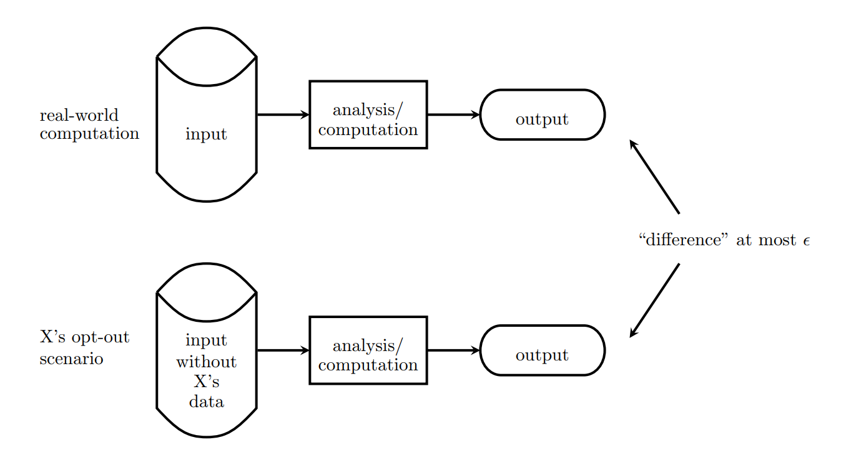
What is Differential Privacy?

Slide 29
References
CDAC Website
https://dpt.sanacloud.com/DataProtectionToolkit/
CDAC Working Paper 22
https://nces.ed.gov/FCSM/about_cdac.asp

