Slide 1
Measuring Health Inequities when Administrative or Self-Reported Race/Ethnicity Data is Incomplete
Marc N. Elliott
National Network Workshop, UCLA
October 8, 2021

Slide 2
Outline
Why Indirectly Estimate Race-and-Ethnicity?
The Bayesian Improved Surname and Geocoding Approach (BISG) and Medicare BISG (MBISG)
Applications
Concerns
Use of M(BISG) / Future Directions

Slide 3
Race/Ethnicity Data Are Essential for Monitoring Quality, Coverage, Cost, and Access
The Affordable Care Act requires all federal data collection efforts to obtain information on race, ethnicity, sex, primary language, and disability status
The gold standard for race-and-ethnicity measurement is self-report
  Sometimes only imperfect administrative information is available for Medicare and other data
    3rd party report
    Constrained response options
  Self-reported data can have high, non-random missingness
    30% missing in Marketplace data
    Often higher in commercial health plan data
Missing or poorly-measured race-and-ethnicity data create barriers to monitoring and improving quality, coverage, cost, and access

Slide 4
Problems with Collecting Self-Reported
Race-and-Ethnicity
Historically, concerns about improper use sometimes meant this data was not collected
  A focus on measuring and reducing disparities renewed efforts to collect it
Once you start, self-reported data accumulates slowly
  Enrollment, contact, survey, etc.
  Early responders may be unrepresentative
Indirect estimation can fill a gap as data accumulates

Slide 5
Indirect Estimation of Race-and-Ethnicity Provides Valid Group-Level Estimates
Surnames and residential addresses are widely available and can help impute race-and-ethnicity using a cost-effective, validated method
Indirect estimates can effectively supplement self-reported data or improve biased administrative data
  Can better align this data with what beneficiaries themselves choose when allowed a full set of choices
We describe two related methods RAND has developed to address missing race-and-ethnicity data or improve existing administrative data in general and Medicare contexts
  Not intended for individual-level decision making

Slide 6
The BISG and MBISG Methods
Surnames and residential addresses are widely available and can help impute race/ethnicity in a cost-effective, validated approach
The Bayesian Improved Surname and Geocoding (BISG) approach and Modified BIFSG approaches can be used in any dataset with name and address data to measure and compare racial-and-ethnic groups
  Modified BIFSG adds first name information
The Medicare BISG (MBISG) is a specialized version developed for CMS that takes advantage of additional Medicare data to improve administrative measures of race-and-ethnicity for Medicare beneficiaries

Slide 7
RAND Developed the Bayesian Improved Surname Geocoding (BISG) for General Purposes
Incorporates Census surname list and residential address probabilities, along with fixes for unlisted names and suppressed counts
Produces a vector of six probabilities of being Hispanic, non-Hispanic White, Black, Asian/Pacific Islander (API), American Indian/Alaskan Native (AI/AN), Multiracial
BISG and its variants can be used to make inferences and comparisons of racial-and-ethnic groups in the absence of complete and reliable self-reported data on race-and-ethnicity
The general approach can be tailored to specific populations and administrative datasets

Slide 8
BISG Generates Probabilities, not Classifications
Some approaches classify probabilistic information about race/ethnicity membership and then analyze the data as if race-and-ethnicity were observed
  Classification results in biased estimates and a loss of power that lessens ability to detect group differences
  For more detail, see McCaffrey D, Elliott MN. (2008) and Elliott et al. (2009).
BISG estimates the probability of being in each race-and-ethnicity group and then uses these probabilities directly to make inferences about and compare racial-and-ethnic groups

Slide 9
BISG Is Designed for Making Inferences
About Groups, Not Individual People
BISG does not assign a single race and ethnicity to individual beneficiaries
It generates a set of six probabilities that a beneficiary would self-identify as: AI/AN, API, Black, Hispanic, Multiracial, or White
BISG probabilities reflect the uncertainty associated with each category for each person in the absence of unconstrained self-report
They are tools for measuring differences between racial and ethnic groups, not for assessing individuals
When used in this way, the method can help provide insights and accurate information about—for example—groups of patients at a given hospital or members at a given plan

Slide 10
Indirect Estimation Can Fill a Gap as Data Accumulates
Rather than waiting until a threshold level of self-report is reached to switch from only indirect methods to only self-report, it is better to blend and smoothly incorporate self-report and indirect estimates
  Can use a mixture of probabilities and 1/0 self-report
  These methods can assess the representativeness of early self-reported data by comparing indirect estimates of reporters and nonreporters

Slide 11
Surnames Can Be Linked to Race-and-Ethnicity Probabilities
2010 US Census surname database contains all surnames applicable to 100 or more Americans, along with race-and-ethnicity percentages
  2020 coming soon, we hope
These 151,671 unique surnames cover 89.8% of U.S. population
  Special approach for rare names
name | rank | count | Pct._ white | Pct._ black | Pct._ api | Pct._ aian | Pct._ multirace | Pct._ Hispanic
SMITH | 1 | 2,376,206 | 73.35 | 22.22 | 0.4 | 0.85 | 1.63 | 1.56
JOHNSON | 2 | 1,857,160 | 61.55 | 33.8 | 0.42 | 0.91 | 1.82 | 1.5
WILLIAMS | 3 | 1,534,042 | 48.52 | 46.72 | 0.37 | 0.78 | 2.01 | 1.6
BROWN | 4 | 1,380,145 | 60.71 | 34.54 | 0.41 | 0.83 | 1.86 | 1.64
JONES | 5 | 1,362,755 | 57.69 | 37.73 | 0.35 | 0.94 | 1.85 | 1.44
MILLER | 6 | 1,127,803 | 85.81 | 10.41 | 0.42 | 0.63 | 1.31 | 1.43
DAVIS | 7 | 1,072,335 | 64.73 | 30.77 | 0.4 | 0.79 | 1.73 | 1.58
GARCIA | 8 | 858,289 | 6.17 | 0.49 | 1.43 | 0.58 | 0.51 | 90.81
RODRIGUEZ | 9 | 804,240 | 5.52 | 0.54 | 0.58 | 0.24 | 0.41 | 92.7
WILSON | 10 | 783,051 | 69.72 | 25.32 | 0.46 | 1.03 | 1.74 | 1.73

Slide 12
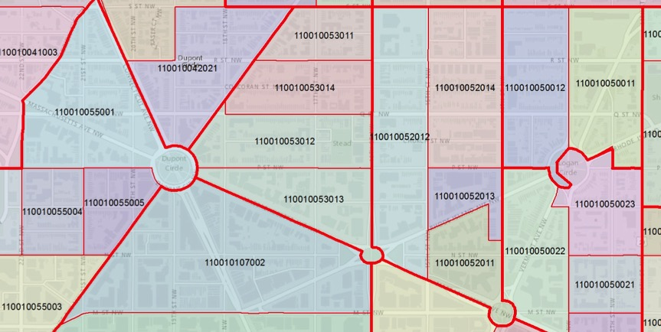
Enrollee Residential Addresses Can Also Be Linked to Race/Ethnicity Information
Enrollee addresses are “geocoded” to identify each enrollee’s census block group
Block group | n_ white | n_ black | n_ api | n_ aian | n_ 2prace | n_ Hispanic
110010053012 | 955 | 41 | 90 | 2 | 34 | 70
110010052012 | 576 | 101 | 34 | 1 | 12 | 60
overall | 197,312,110 | 37,910,674 | 15,140,999 | 2,253,108 | 5,610,074 | 50,477,594

Slide 13
We Combine Both Sources of Information
Initial probabilities based on block group are “updated” using information on surname r/e
Six surname-based probabilities
(“prior” probabilities)
Block group level race/ethnicity tabulations
Bayes’ Theorem
Six “posterior” probabilities
Enrollee | White | Black | API | AIAN | Multi | Hispanic
001 | 0.21 | 0.68 | 0.02 | 0.07 | 0.01 | 0.01

Slide 14
Census Block Group Files Provide Proportions of Residents Belonging to Each Racial-and-Ethnic Group in a Neighborhood
 | Probability of Belonging to a Specific Racial/Ethnic Group
Block Group | AI/AN | Asian | Black | Hispanic | White | Multiracial
1012 | 0 | 0.1 | 0.3 | 0.1 | 0.5 | 0
1223 | 0 | 0.05 | 0.6 | 0.20 | 0.15 | 0
1056 | 0 | 0.1 | 0.3 | 0.2 | 0.4 | 0
Example:
John Lee, 1501 Eastern Blvd, Montgomery, AL 36117

Slide 15
BISG Combines Surname and Block Group Data to Estimate Racial-and-Ethnic Probabilities
Surname R/E Information
 | Proportion Belonging to a Specific Racial/Ethnic Group
Surname | AI/AN | Asian | Black | Hispanic | White | Multiracial
Learner | 0 | 0.1 | 0.1 | 0.15 | 0.65 | 0
Lee | 0 | 0.5 | 0.35 | 0.0 | 0.15 | 0
Lopez | 0.05 | 0.0 | 0.1 | 0.65 | 0.2 | 0
 | Probability of Belonging to a Specific Racial/Ethnic Group
Block Group | AI/AN | Asian | Black | Hispanic | White | Multiracial
1012 | 0 | 0.1 | 0.3 | 0.1 | 0.5 | 0
1223 | 0 | 0.05 | 0.6 | 0.2 | 0.15 | 0
1056 | 0 | 0.1 | 0.3 | 0.2 | 0.4 | 0
Uses Bayesian statistical methods to combine information
BISG Algorithm
 | Probability of Belonging to a Specific Racial/Ethnic Group
Member | AI/AN | Asian | Black | Hispanic | White | Multiracial
A | 0 | 0.1 | 0.2 | 0.12 | 0.58 | 0
B | 0 | 0.3 | 0.5 | 0.05 | 0.15 | 0
C | 0.03 | 0.05 | 0.2 | 0.5 | 0.3 | 0
J. Lee from Alabama

Slide 16
MBISG Developed to Help CMS Measure Racial/Ethnic Equity in HEDIS Data
CMS’s Office of Minority Health wanted to compare HEDIS clinical quality of care measures by race/ethnicity
CMS only had administrative race/ethnicity based on the Social Security Administration form that only allowed Black/White/Other before 1980
  Measured Black vs. not Black well
  Misclassified many API and Hispanic beneficiaries as White or Other
We developed a Medicare-specific algorithm to enable HEDIS comparison by race/ethnicity, using name, address, and administrative information
  National and plan-level data appear on CMS’ Website https://www.cms.gov/About-CMS/Agency-Information/OMH/research-and-data/statistics-and-data/stratified-reporting.html
  Better aligns this data with what beneficiaries themselves choose when allowed a full set of response options

Slide 17
Original CMS Variable Misclassifies
Many Medicare Beneficiaries
 |  | Original CMS (Social Security Administration) Variable
 |  | White | Black | Hispanic | API | AI/AN | Other | Missing
Self-report | White | 97.2 | 0.1 | 0.1 | 0.1 | 0.1 | 0.4 | 2.1
 | Black | 0.6 | 97.9 | 0.2 | 0.1 | 0.0 | 0.6 | 0.7
 | Hispanic | 58.1 | 4.1 | 30.1 | 0.4 | 0.3 | 5.7 | 1.4
 | API | 5.2 | 0.7 | 0.6 | 54.5 | 0.3 | 35.0 | 3.8
 | AI/AN | 30.6 | 7.2 | 1.5 | 0.7 | 56.1 | 3.5 | 0.5
 | Multiracial | 64.2 | 25.4 | 0.5 | 1.6 | 4.3 | 2.3 | 1.8
Weighted Distribution of 2019 MA/FFS Survey Respondents

Slide 18
Overview of the MBISG Method
MBISG 2.1 (see Haas et al., 2019 for version 2.0) uses the original beneficiary-reported data on race and ethnicity and supplements it by taking into consideration a beneficiary’s neighborhood composition and other information supplied by beneficiaries
Turns CMS administrative classification into a vector of racial-and-ethnic probabilities using previous self-reported data from a national survey of Medicare beneficiaries, poststratified to CMS enrollment files
Independently calculates a vector of BISG racial-and-ethnic probabilities from name and address
Uses similar Bayesian approach to integrate these two estimates, using three initial information sources
Also incorporates additional data elements and more flexible modeling
Substantially improves the original CMS variable

Slide 19
Data and Methods
Analyses employ Medicare CAHPS data (n=284,627)
  Permits linking self-reported race-and-ethnicity data to CMS administrative data
Predicted probabilities are checked by:
  Assessing concordance with self-reported data
  Comparing mean predicted probabilities for each racial-and-ethnic group to the corresponding prevalence in self-reported data (calibration)
Evaluation of models uses 10-fold cross-validation:
  Randomly divided the observations into 10 equal parts
  Fit each model on 90% of the sample and used that model to estimate racial-and-ethnic probabilities for the remaining 10%
  Correlated these out-of-sample predictions with self-reported race-and-ethnicity
  Averaged the 10 sets of correlations

Slide 20
MBISG 2.1 Substantially Improves the Original CMS Variable

Slide 21
Concordance of BISG 1.0, Modified MBISG, MBIFSG 2.1 with Self-Report
Concordance of 92-98% for API, Black, Hispanic, White for BISG 1.0
  Surname, Address
  Not recommended for AI/AN, Multiracial inferences
Concordance of 95-98% for API, Black, Hispanic, White, for Modified BIFSG
  First Name, Surname, Address
  Careful use for AI/AN (c=0.80)
  Not recommended for Multiracial inference (c=0.69)
Concordance of 96-99+% for Hispanic, White, Black, API for MBISG 2.1
  Name, Address, SSA r/e, other Medicare fields
  Some use for AI/AN (c=0.84)
  Not recommended for Multiracial inference (c=0.71)
1.0 perfect, 0.9 excellent, 0.8 good, 0.7 adequate, 0.5 chance

Slide 22
Applications
National and Contract-Specific Stratified Reporting by Race/Ethnicity
A Health Equity Summary Score to Incentivize Excellent Care to At-Risk Groups
Measuring racial/ethnic differences in voluntary disenrollment from Medicare plans
Imputing Race-and-Ethnicity for Survey Respondents who did not report Race-and-Ethnicity
Estimating Enrollment by Race-and-Ethnicity in Marketplace Plans
Racial-and-Ethnic Inequities in Behavioral Health Quality Measures in Medicare Health Plans
Detect and Correct Bias in Clinical Decision Algorithms or p4p Schemes
Combine with GIS Mapping

Slide 23








Race/Ethnicity Estimation Project
BISG method endorsed by the National Academy of Medicine, NCQA, NQF, and other entities
BISG method used by:
  Numerous leading national and regional health plans, such as: consider just listing instead of logs given mergers
  Centers for Medicaid and Medicare Services
  Consumer Financial Protection Bureau
  Massachusetts CHIA
  l;

Slide 24
Race-and-Ethnicity Probabilities
Can Be Used Directly
Use case | Example | Analytic approach
Measure population sizes | Percentage of plan enrollees in each racial-and-ethnic group | Sum probabilities for counts and average for %
Stratified measurements | Percentage of plan enrollees who received colorectal cancer screenings in a single racial-and-ethnic group | Calculate weighted averages for a group (weights are race-and-ethnicity probabilities)
Regression analysis | Association between race-and-ethnicity and per-capita medical spending | Include race-and-ethnicity probabilities as predictors, with or without additional covariates
Estimates are most accurate when probabilities are used directly
Imputation/PROC MI Analyze, regression, or sometimes weighting

Slide 25
Some Previous Applications of RAND’s BISG Tool
Massachusetts Center for Health Information and Analysis (CHIA)
  R/e imputations were added to state’s All-Payer Claims Database
  5 years of data, 240 million cases
Health NET
  R/e imputations were conducted to identify quality gaps, support quality improvement
CMS OMH (https://www.cms.gov/About-CMS/Agency-Information/OMH/research-and-data/statistics-and-data/stratified-reporting.html)
  Stratified reporting of quality measures for each Medicare Advantage contract by r/e
Exchanges

Slide 26
Application 1:
National and Contract-Specific Stratified Reporting by Race/Ethnicity
Public reporting of HEDIS measure scores by race-and-ethnicity (API, Black, Hispanic, and White) at the national level
Public reporting of HEDIS measure scores by race-and-ethnicity (API, Black, Hispanic, and White) at the Medicare Advantage health plan contract level
In both cases, MBISG racial-and-ethnic probabilities are used directly in regression models to aggregate across beneficiaries in a way that is similar to weighting performance data by the probabilities
  Allows us to show stratified estimates like you would get with self-reported data, but without ever having to classify a person as belonging to a group
National and plan-level stratified data appear on the CMS Office of Minority Health website

Slide 27
Application 2:
A Health Equity Summary Score to Incentivize Excellent Care to At-Risk Groups (Agniel et al., 2021)
We created scores summarizing how well and how equitably Medicare Advantage health plans perform for specific beneficiary groups (dual or LIS eligible, API, Black, and Hispanic) on sets of HEDIS and CAHPS measures
These two summary scores consider:
  Current levels of care
  Within-plan improvement in care, including closing gaps
  Nationally-benchmarked improvement in care
MBISG is used in creating the HEDIS summary score
  Racial-and-ethnic probabilities are used directly in regression models to aggregate in a way that is similar to weighting performance data by the probabilities

Slide 28
Application 3: Measuring racial/ethnic differences in voluntary disenrollment from Medicare plans
 | Overall
 | Unadjusted disenrollment rate | Adjusted disenrollment rate | Difference of adjusted disenrollment rate from whites
White | 7.7 | 8.5 | --
API | 8.7 | 9.2 | 0.7***
Black | 10.0 | 10.2 | 1.7***
Hispanic | 13.5 | 12.3 | 3.8***
*** p < 0.001 for all comparisons
We linked voluntary disenrollment information to MBISG 2.0.

Slide 29
Application 4: Imputing Race-and-Ethnicity for Survey Respondents who did not report Race-and-Ethnicity
(Dembosky et al. 2018)
 | Estimated % who did not self-report race-and-ethnicity | Estimated % who broke off from survey before demographic section | Estimated % who did not self-report race-and-ethnicity among those who did not break off from survey
White | 3.2% | 1.0% | 2.2%
Black | 6.6%* | 2.1%* | 4.5%*
Hispanic | 4.7%* | 2.2%* | 2.6%*
API | 4.7%* | 1.5%* | 3.2%*

Slide 30
Application 5:
Estimating Enrollment by Race-and-Ethnicity in Marketplace Plans
30% missing; nonreporters more likely to be Black, Hispanic
Using BISG estimates, we also found that non-reporters were 1.5x more likely to be Black and Hispanic than reporters
Race-and-Ethnicity | Self-Reported Race-and-Ethnicity N % |  | Combined Self-Reported and Estimated Race-and-Ethnicity %
Missing | 7,169,880 | 29.83 | 0.08
American Indian/Alaska Native | 71,216 | 0.30 | 0.43
Asian/Pacific Islander | 1,391,861 | 5.79 | 7.56
Black | 2,297,414 | 9.56 | 14.74
Hispanic | 2,629,811 | 10.94 | 16.97
Multiracial | 214,856 | 0.89 | 1.27
White | 10,260,381 | 42.69 | 58.95
Total | 24,035,419 | 100.0 | 100.00

Slide 31
Application 6: Racial-and-Ethnic Inequities in Behavioral Health Quality Measures in Medicare Health Plans
(Breslau et al. 2018)
Quality of behavioral health care data for older adults may be lower for API, Black, and Hispanic than for non-Hispanic White adults
Unlike other types of medical care, within-plan inequities may be prominent in behavioral health
  Variation within providers tends to be larger for processes involving patient counseling
  Differences by race-and-ethnicity in views of behavioral health care
We describe variation in care by beneficiary race-and-ethnicity
  Within Medicare Advantage contracts
  Across contracts

Slide 32
Overall Antidepressant Medication Management Worse for Black, Hispanic, and API Beneficiaries

Slide 33
Measures with Larger Overall Disparities Tend to Have Disparities Concentrated with Contracts

Slide 34
Application 7: Detect and Correct Bias in Clinical Decision Algorithms or p4p Schemes
  Clinical decision algorithms may make inequitable decisions with respect to race/ethnicity
    Direct use of race/ethnicity in harmful ways
    Unintended use of proxies for race/ethnicity
    Treating current practice as reflecting need or optimal practice can perpetuate biased practices
    Can use BISG to detect biased rules and correct for indirect effects via pre- or post-processing
  Pay-for-performance programs may have the undesired effects of moving resources away from providers who care for disadvantaged patient populations
    If payment increases with quality and underserved patients tend to have worse providers, hospitals, plans, etc.
    Can apply BISG to an approach described by Damberg et al (2015) to ensure $/patient for any p4p scheme are uncorrelated with the racial/ethnic composition of a medical group, patient population etc., while still preserving incentives

Slide 35
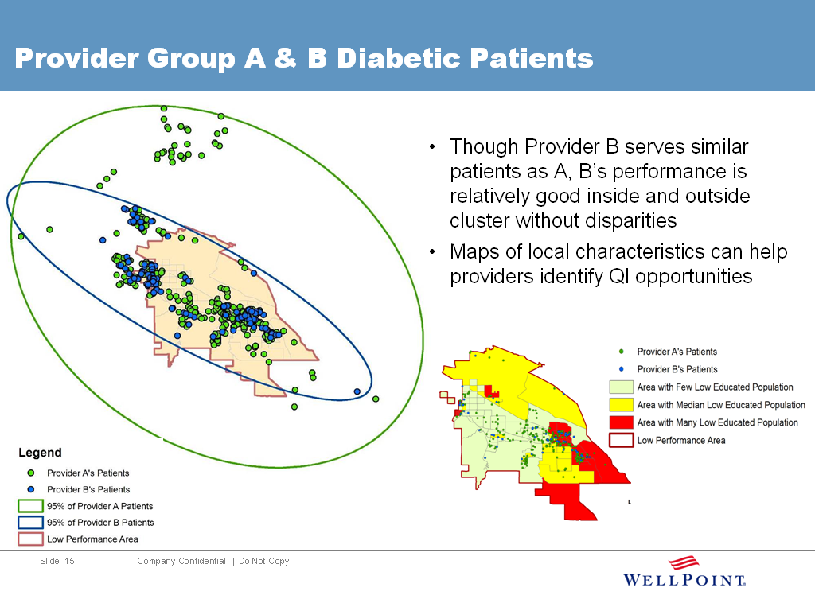

Application 8: Combine with GIS Mapping-
Provider A & B Diabetic Patients

Slide 36
How might cost-effectiveness vary depending on intervention approach and targeting?
Target all with simple intervention (mailing)?
Tailor interventions depending on subgroup (mailing + intensive)?
Intensive intervention vulnerable subgroup only (intensive)?
Hispanic - poor
Hispanic – affluent
White/Other

Slide 37
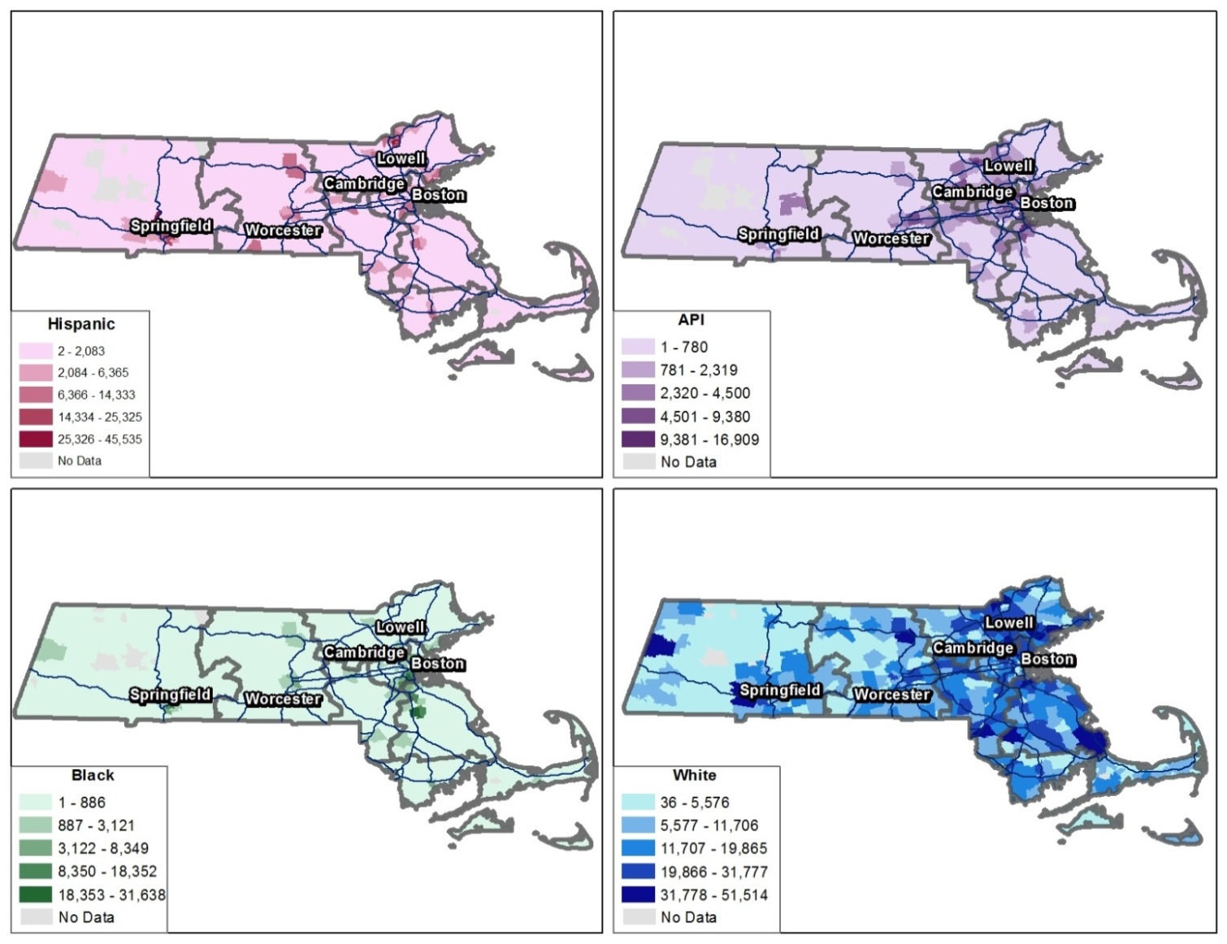
Validation
Using the Indirect Estimates
Next steps
Additional Uses Example: Statewide Distribution of MA Residents with Medical Coverage
NOTE: The White population mirrors the overall population distribution in MA, while minorities are concentrated in larger cities
SOURCE: 2013 APCD Member Eligibility File

Slide 38
Concerns
MBISG Is Primarily Used to Enhance Limited Self-Reported Data
Geographic Stratification Alone as an Alternative Method of Indirect Estimation
An Analogous Use of Indirect Estimation by the U.S. Census Bureau

Slide 39
MBISG Is Primarily Used to Enhance Limited Self-Reported Data
Some critics of MBISG have suggested that the method is primarily used when people have chosen not to report their race or ethnicity
In fact, MBISG is used almost entirely for beneficiaries who were not allowed to report their race and ethnicity in the categories they prefer
When asked to do so on the Medicare CAHPS survey, more than 95% of all Medicare beneficiaries report their race and ethnicity; almost all of those who do not provide this information simply do not get to the last section of the survey (Dembosky et al., 2018)
By drawing on other sources of data to enhance self-reported information about race and ethnicity collected under constraints, MBISG
  Allows beneficiaries to be represented in data sets in a way that they prefer
  Allows policymakers to accurately identify disparities

Slide 40
Geographic Stratification as an alternative to MBISG 2.1
MBISG 2.1 produces more accurate results than methods that use geographic stratification only
Compared to MBISG 2.1, geographic stratification by block group results in:
  3.06 times as much error variance for API
  2.62 times as much error variance for Hispanic
  2.12 times as much error variance for Black
  2.08 times as much error variance for White
Also overlooks known disparities by race and ethnicity within block groups

Slide 41
An Analogous Use of Indirect Estimation by the U.S. Census Bureau
The Census Bureau seeks and uses direct person-level data on race and ethnicity where possible, but recognizes that stopping there would lead to systematic undercounting of underserved groups and misallocation of federal resources
Much as MBISG 2.1 is used to accurately measure quality of care by race and ethnicity, the Bureau uses imputation at an aggregated level to prevent systematic underrepresentation of groups that include Black and Hispanic people (Bazelon & Wines, 2021)
One of the main reasons that we know how America’s population has changed in the last 10 years is because the Census uses indirect estimation alongside direct self-report to ensure accurate and equitable overall measurement

Slide 42
Using The (M)BISG
RAND has a new BISG Website
  https://www.rand.org/health-care/tools-methods/bisg.html
  We distribute code and are in the process of updating it
MBISG data are regularly computed for all Medicare beneficiaries and decedents and are available via the CCW

Slide 43
Future Directions
Improved, more specific handling of multiracial identity
Improved performance for AI/AN and multiracial
Fully cross-tabulating Hispanic ethnicity and race
Finer-grained API categories and Hispanic ethnicity categories by national origin
Broader imputation of preferred language
Tailoring to new settings-Medicaid, Marketplace, etc.
Much of this can be done if new Census data requests are fulfilled

Slide 44
References
Agniel D, Martino SC, Burkhart Q, Hambarsoomian K, Orr N, Beckett MK, James C, Hudson Scholle S, Wilson-Frederick S, Ng J, Elliott MN (2019) “Incentivizing Excellent Care to At-Risk Groups with a Health Equity Summary Score” JGIM doi: 10.1007/s11606-019-05473-x
Bazelon E and Wines M. (2021). How the Census Bureau Stood Up to Donald Trump’s Meddling. New York Times. Available at: https://www.nytimes.com/2021/08/12/sunday-review/census-redistricting-trump-immigrants.html
Breslau J, Elliott MN, Haviland AM, Klein DJ, Dembosky JW, Adams JL, Gaillot S, Horvitz-Lennon M, Schneider EC. (2018) “Racial/Ethnic Disparities in Attainment of Behavioral Health Quality Measures in Medicare Advantage Plans” Health Affairs 37(10) 1685-1692.
Damberg C, Elliott MN, Ewing B. (2015) “Pay-for-Performance Schemes that Use Patient and Provider Categories Would Reduce Payment Disparities” Health Affairs 34(1): 134-142
Dembosky JW, Haviland AM, Haas A, Hambarsoomian K, Weech-Maldonado R, Wilson-Frederick SM, Gaillot S, Elliott MN. (2018) “Indirect Estimation of Race/Ethnicity for Survey Respondents who do not Report Race/Ethnicity” Medical Care 57(5): e28-e33. doi: 10.1097/MLR.0000000000001011
Elliott MN, Morrison PA, Fremont A, McCaffrey DM, Pantoja P, Lurie N. (2009). “Using the Census Bureau’s Surname List to Improve Estimates of Race/Ethnicity and Associated Disparities.” Health Services and Outcomes Research Methodology, 9(2):69-83
Haas A, Elliott MN, Dembosky JW, Adams JL, Wilson-Frederick S, Mallett JS, Gaillot S, Haffer SC, Haviland AM. (2018) “Imputation of Race/Ethnicity to Enable Measurement of HEDIS Performance by Race/Ethnicity” Health Services Research 54(1): 13-23. DOI: 10.1111/1475-6773.13099
McCaffrey D, Elliott MN. (2008). “Power of Tests for a Dichotomous Independent Variable Measured with Error.” Health Services Research, 43(3): 1085-1101

Slide 45
Validation
Using the Indirect Estimates
Next steps
Additional sources of IE literature
Stephen F. Derose, Richard Contreras, Karen J. Coleman, Corinna Koebnick, and Steven J. Jacobsen. “Race and Ethnicity Data Quality and Imputation Using U.S. Census Data in an Integrated Health System: The Kaiser Permanente Southern California Experience. Medical Care Research and Review, 70(3): June 2013, 330-345.
Dzifa Adjaye-Gbewonyo, Robert A. Bednarczyk, Robert L. Davis, and Saad B. Omer. “Using the Bayesian Improved Surname Geocoding Method (BISG) to Create a Working Classification of Race and Ethnicity in a Diverse Managed Care Population: A Validation Study.” Health Services Research, 49(1): February 2014, 268-283.
Joel Weissman and Romana Hasnain-Wynia. “Advancing Health Care Equity Through Improved Data Collection.” New England Journal of Medicine, 364(24): 16 June 2011, 2276-2277.
RAND Corporation
Generating Indirect Estimates of Race/Ethnicity
Generating and Using Language Indirect Estimates

Slide 46
Backup Slides

Slide 47
BISG Method – Inputs Needed
From Administrative Files
  Member last name
  Member residential address or geocode (to Block Group level)
  Optional: Self-reported or other reliable direct source of R/E data if available
From Census Files:
  Census Surname List
  Census Demographic file (to Block Group level)
Algorithm
  Member surname/Census list generate “prior probability” of r/e group
  Member neighborhood Census provides r/e neighborhood composition
  Bayesian methods combine both types of information for final estimate

Slide 48
Preparing Self-Reported Race/Ethnicity Data
Race/Ethnicity | Options (Select All That Apply)
Race | American Indian/Alaska Native
 | Asian Indian
 | Chinese
 | Japanese
 | Korean
 | Native Hawaiian
 | Other Asian
 | Other Pacific Islander
 | Filipino
 | Guamanian/Chamorro
 | Samoan
 | Vietnamese
 | Black/African American
 | White
 | Unknown
Hispanic Ethnicity | Cuban
 | Mexican, Mexican American or Chicano/a
 | Puerto Rican
 | Unknown
ssdfd
AI/AN
Asian/
Pacific
Islander
Two or
More:
Multiracial
Black
White
Hispanic

Slide 49
Rules for Categorizing Self-Reported Race/Ethnicity into 6 Mutually Exclusive Groups
Hispanic ethnicity +/- other races -> Hispanic
Non-Hispanic respondents who reported two or more races were classified as multiracial, with the exception of those who selected two or more from among the following options (but no other race): “Asian Indian”, “Other Indian”, “Chinese”, “Japanese”, “Korean”, “Native Hawaiian”, “Other Asian”, “Other Pacific Islander”, “Filipino”, “Guamanian or Chamorro”, “Samoan”, “Vietnamese.” These enrollees were classified as API.
Non-Hispanic respondents who reported exactly one race were classified as AI/AN, API, black, or white, according to their response.

Slide 50
Geocoding Enrollee Residential Addresses
Goal: Identify each enrollee’s census block group
Requires geocoding software (e.g., ArcGIS)
Software identifies X,Y coordinates using the most precise geographic information possible:
  Full address
  9-digit zip code
  5-digit zip code
Software then links coordinates to a single block group

Slide 51
Formatting Enrollee Surnames
Goal: Enable merging of enrollee names with Census surname dataset
Examples:
  Mrs. Kim -> KIM
  Smith Jr. -> SMITH
  Wilson III -> WILSON
  Davis Ph.D. -> DAVIS
  Beck-Sullivan -> BECKSULLIVAN
  De La Luz -> DELALUZ

Slide 52
Generating Preliminary Race/Ethnicity Probabilities
Apply Bayes’ Theorem to generate 6 posterior probabilities
Illustrative calculation for 1 of the 6 probabilities:
p(Black|surname s, blkgrp b) =
p(Black|surname s)*p(blkgrp b|Black)
p(AIAN|surname s)*p(blkgrp b|AIAN) +
p(API|surname s)*p(blkgrp b|API) +
p(Black|surname s)*p(blkgrp b|Black) +
p(Hispanic|surname s)*p(blkgrp b|Hispanic) +
p(White|surname s)*p(blkgrp b|White) +
p(Multiracial|surname s)*p(blkgrp b|Multiracial)

